Slide 1
Customer Booking Behaviour
British Airways
By Usman Arif

Slide 2
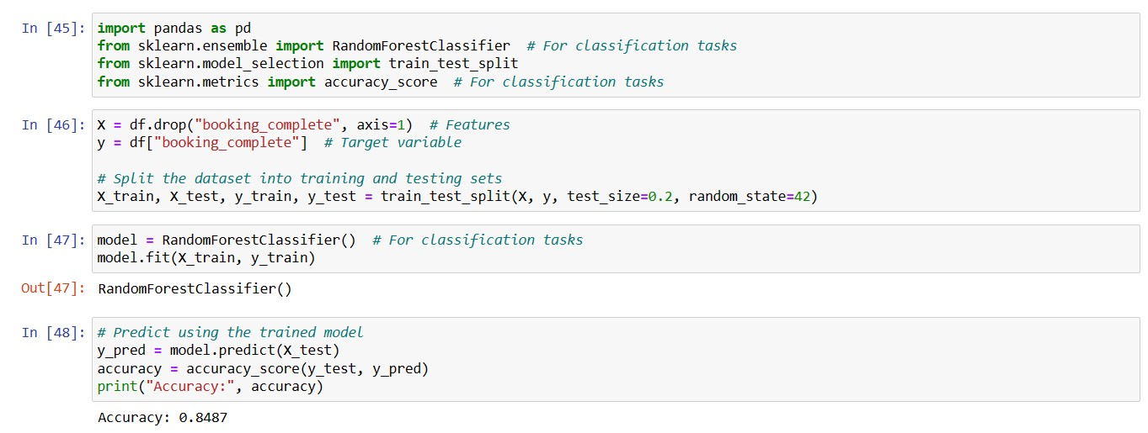
Model Trained for Customer Booking Behavior Prediction
The Trained Model has a prediction accuracy of 84.87%

Slide 3
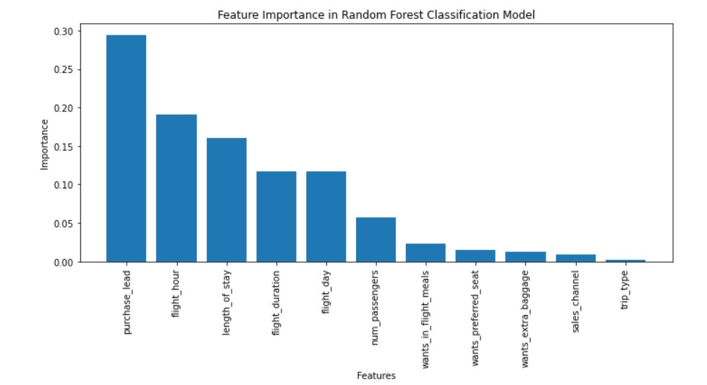
Feature Importance in behavior prediction

